Slide 1
A Closer Look at Denial
Bob Carty LCSW, CADC
Shawntrell MOORE, MA, LCPC, CADC

Slide 2
Introductions
Co-Trainers
Participants’ Poll

Slide 3
Learning Objectives
Explain key concepts related to denial
Describe trauma’s impact on denial
Examine Gorski’s denial patterns
Discuss how family members and counselors may experience denial
Identify strategies and interventions to recognize and reduce denial

Slide 4
What Is Denial?
Often initially described as “lying to oneself and others” -- seems to imply a conscious process
Denial is also an unconscious, psychological defense that is triggered by a perceived threat, activating certain thoughts and behaviors

Slide 5
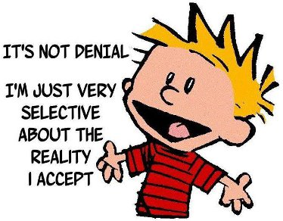
The D’s of Denial
D-words related to denial…
Disbelief
Distortions
Deception
Distractions
Discrepancies
Delusion

Slide 6
Key Concepts
Progression of denial
Its expansive nature
Neuroscience of denial

Slide 7
Progression of Denial
If addiction is progressive, consider that denial is also progressive
Greater denial is needed to block out escalating devastation
The more that one’s life is out of control, the more one needs to “prove” to oneself and others that everything is OK

Slide 8
Jellinek Chart

Slide 9
Its Expansive Nature
As denial increases, it expands to areas other than one’s substance use
Any perceived criticism and judgment may trigger defenses within the person with advanced addiction
Lying about unimportant things

Slide 10
Sam’s Story

Slide 11
Neuroscience of Denial
Trauma Response
Pre-frontal cortex to Amygdala
Findings from Jamie Marich
Trauma responses: emotional numbness, difficulty focusing, distractability, etc.

Slide 12
Denial in Treatment
Entering treatment does not end denial; but may even enhance this unconscious, psychological defense
This leads to:
Hiding behind a false sense of being in control
Comparing oneself to others who may have more severe problems

Slide 13
Denial Patterns

Slide 14
Gorski’s Denial Patterns
Avoidance
Absolute denial
Minimizing
Rationalizing
Blaming
Comparing
Compliance
Manipulating
Flight into health
Recovery by fear
Strategic hopelessness
Democratic disease state

Slide 15
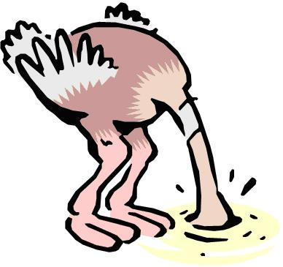
Avoidance
Defocusing from one’s substance use
When others try to raise this issue, the person typically responds by changing the subject or by getting angry to shut down the discussion
Avoidance can occur in response to direct questions during intake sessions

Slide 16
Minimizing
May be conscious or unconscious
Individual tends to lessen his/her report regarding
Frequency of use
Amounts used
Consequences of use

Slide 17
Blaming
Allows the individual to avoid responsibility for one’s substance use disorder
Others are the “reason” for one’s use
“If you had a spouse like mine, you would drink too”
“I got a DUI again because the cops are out to get me”
Others?

Slide 18
Compliance
Individual seems to “go along” with what is requested, but shows no real change
Promises to stop drug use are made, yet the person simply tries to hide the drug use better
These promises get the “heat” off for a while
Some clients are “stars” in treatment and end up relapsing shortly after discharge

Slide 19
Flight into Health
Some clients are pleased to feel better physically and emotionally in early recovery
As they feel better, they think that they do not need to:
Continue counseling
Attend meetings
Maintain contact with supportive peers in recovery

Slide 20
Strategic Hopelessness
People with multiple recovery attempts may conclude that their situation is hopeless, instead of trying new ways to get and stay sober
May lead to fighting off efforts of others to help them
May even ask others to simply leave them alone

Slide 21
Small Group Exercise
In groups of 2-4 people with one reporter
Select one of the two clinical summaries
Discuss these questions:
Which of Gorski’s denial patterns are present?
How would you address these denial patterns in treatment?

Slide 22
Unaddressed Denial
Discussion Question: If denial is not addressed in treatment, how does that impact early recovery following discharge?

Slide 23
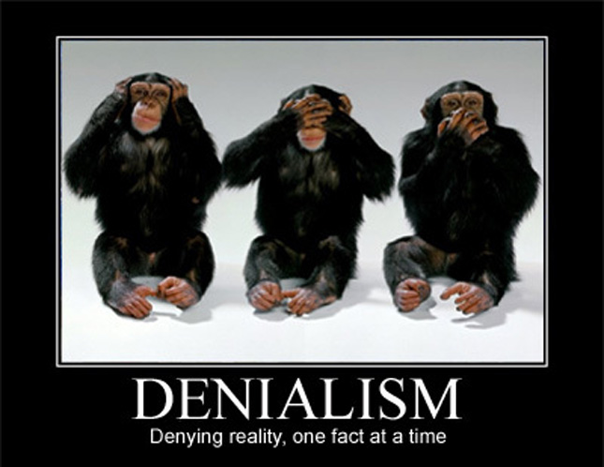
Denial by Others

Slide 24
Denial by Family
Enabling (rescuing, ignoring problems, buying the alcohol, etc.)
Trauma bonding
Guilt and shame
Keeping secrets (cultural)

Slide 25
Denial by Counselors
Denial can interfere with the countertransference process
Responses that look like denial – Fight, Flight, Freeze, Fawn
Factors fueling denial – upward mobility, fear of being written up, etc.

Slide 26
Counselor Example
Large group exercise
Review the summary
What patterns of denial do you see?

Slide 27
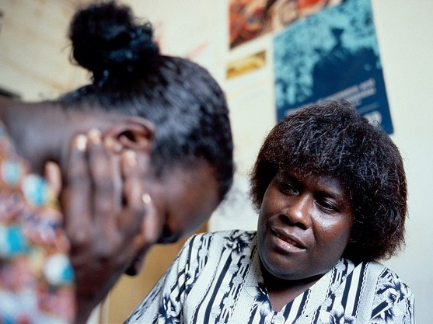
Methods to Reduce Denial

Slide 28
Clinical Strategies
Educate clients on both conscious and unconscious elements of denial
Encourage clients to decrease conscious forms of denial – helping them to catch themselves lying
Help patients to identify which ones of Gorski’s denial patterns they use, thus increasing self-awareness

Slide 29
Motivational Interviewing
Techniques include open-ended questions, affirmations, reflective listening, and summarizing
These help to
Promote clinical engagement and trust
Develop discrepancy, which uncovers denial and ambivalence
Enhance motivation to change

Slide 30
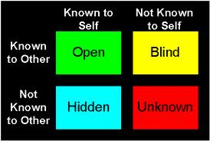
Johari Window
Useful tool to reduce “blind spots” and hidden areas of oneself

Slide 31
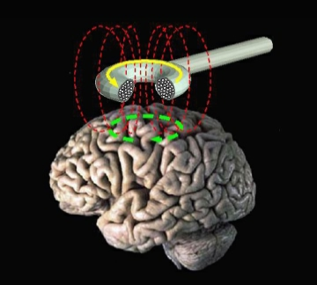
Transcranial Magnetic Stimulation Therapy
What is TMS?
Its benefits
Findings from studies

Slide 32
TMS Continued

Slide 33
Writing Assignments
Tools to help deepen self-awareness
List of pros and cons to change
Step One worksheets
Letter to one’s substance use disorder or to self

Slide 34
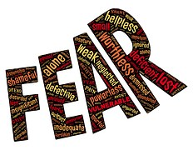
Naming Fears
As denial is triggered by perceived threats, it’s valuable to help individuals see what they fear
Fear of change/unknown
Fear of losing friends
Fear of missing out (FOMO)
Fear of trusting others
Fear of failure

Slide 35
Contact Info
Bob Carty, LCSW, CADC
bobcarty67@gmail.com
(224)456-5147
Shawntrell Moore, MA, LCPC, CADC
smoor15@gmail.com
(217)816-1154

Slide 36
Closing Comments

